Slide 1
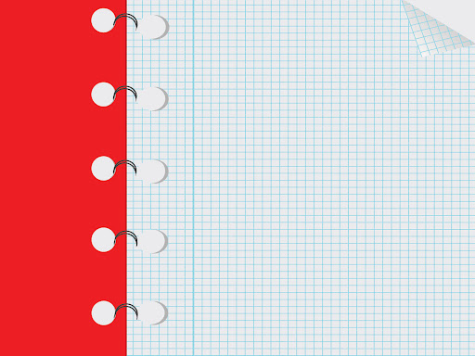
My Blog Site’s Success

Slide 2

These are the apps used in creating my online blog:
CANVA
> I used this app in order to make my info graphics more pleasing and visually appealing to the viewers. Canva is a graphic design platform, used to create social media graphics, presentations, posters, documents and other visual content. The app includes templates for users to use. The platform is free to use and offers paid subscriptions such as Canva Pro and Canva for Enterprise for additional functionality.

Slide 3

YOUTUBE
>It is a audio- video site that is very useful to me and to my research, since it lets me have a deeper comprehension of information that I gain on Google and also if I am tired of reading facts and data on Google, I can always rely on this app for it has audio and I can listen while resting.

Slide 4

GOOGLE
>This is the site that I used in searching tools and information that is needed to my blog. This site has a variety of data which also helps my research to be more informative and reliable.

Slide 5

WORDPRESS
>It is the site where I created my own blog site. It is beginner friendly and has a lot of cool and beautiful templates that can suit every mood or style that I want for my blog site and additional to this is it has a free version where you can create website for free.

